Slide 1

St. Francis Institute of Technology Department of Computer Engineering
Mini Project Title: Detecting Insulting Tweets
Group Members:
Under the guidance of
Mrs. Anuradha Srinivasaraghavan
Associate Professor
Madhura Angchekar- 05
Kinen Cardoza- 09
Velina Cutinha- 14

Slide 2
Content
Introduction
Problem Statement
Proposed Solution
Work Flow of the system
Algorithm with Implementation details
Experimental Set Up
Data Set
Performance Evaluation Parameters
Results & Discussion
Conclusion
References

Slide 3
Introduction
Social Media has become a very powerful tool for information exchange as it allows users to not only consume information but also share and discuss various aspects of their interest.
Despite widespread recognition of the problems posed by social media content, reliable solutions even for detecting Insulting comments are lacking.
The main goal of this study is to develop a reliable tool for detection of Insulting tweets

Slide 4
Application:
It easier for people to detect the ones who are spreading hate and charge the person using law.
The project will be helpful to not only upcoming youngsters but also day to day normal people as crimes will happen less and one can save lives too.
Research:
Detecting Insulting tweets is most popular in research as the Advance technology is all related to social media.
So the model will help to differentiate the positive and negative tweets in a particular social media or any other platform.

Slide 5
Problem Statement
The aim of the study is to evaluate the performance for sentiment classification in terms of accuracy, precision and recall. Apart from the system’s ability to predict for a given tweet whether it is offensive or not.
The proposed solution to this overwhelming problem is the building of such a model with the help of Machine learning that is able to differentiate between Offensive and Non Offensive comments.

Slide 6
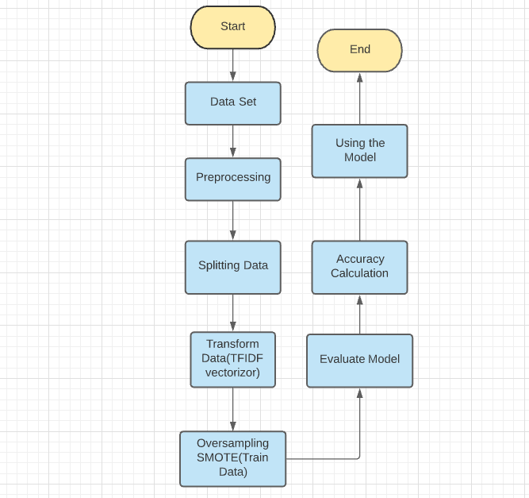
Work Flow of the system

Slide 7
Algorithm with Implementation Details
1. Naïve Bayes:
Multinomial Naive Bayes classification algorithm tends to be a baseline solution for Detecting Insulting Tweets task.
The basic idea of Naive Bayes technique is to find the probabilities of classes assigned to texts by using the joint probabilities of words and classes.
Logistic Regression:
The model is been used to classify the tweets either Offensive or
Non Offensive .In the process we have upload the dataset and Preprocessed
the data used NLTK then split the data applied the model and got the
accuracy.

Slide 8
Algorithm with Implementation Details
Algorithm:
Import dataset and preprocess it
Splitting the data into Train and Test Data
Applying TFIDF vectoriser in order to convert a collection of raw documents to a matrix of TF-IDF features.
Oversampling Data in order to Balance the unbalanced Dataset.
Evaluate the model that is a) Naïve Bayes b) Logistic Regression.
Calculating accuracy of each train model.
Using the model having best accuracy.

Slide 9
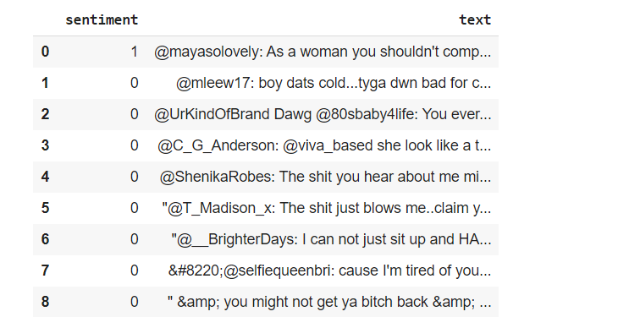
Experimental Setup
We have got the Dataset from Online website where the Dataset consist of more than 24000 tweets .
In which 20000 above are Negative tweets and 4000 above are positive tweets where 0 indicate Offensive tweets and 1 indicates Non Offensive Tweets.

Slide 10
Results and Discussions
With the help of Machine learning we can detect insulting tweets .
First with the dataset we split the data in order to achieve better result after that we applied TFIDF on our 24000 above tweets
Oversampled it to balance the dataset and applied the model that is Logistic Regression and Naïve Bayes.

Slide 11
Results and Discussions
After Evaluating the model we got accuracies and that are
Naïve Bayes:- 0.90
Logistic Regression:- 0.96
Hence we applied logistic regression due to highest accuracy and GUI was made with the help of Streamlit.

Slide 12
Conclusion
In this work, we proposed a new method to detect Insulting Tweets in Twitter. Our proposed approach automatically detects Insulting speech patterns and most common unigrams and use these along with sentimental and semantic features to classify tweets into Offensive and Non Offensive.
Our proposed approach reaches an accuracy equal to 96% for the Logistic Regression into Offensive and Non Offensive.

Slide 13
References
[1] Peter Burnap and Matthew Leighton Williams. 2018.Insulting tweets, machine classiﬁcation and statistical modelling of information ﬂows on Twitter: Interpre-tation and communication for policy decision making. Policy and Internet, 7(2):223–242
[2] Lei Gao and Ruihong Huang. 2017. Detecting online Insulting Texts using context aware models. CoRR,abs/1710.07395
[3] Despoina Chatzakou, Nicolas Kourtellis, Jeremy Blackburn, Emiliano De Cristofaro, Gianluca Stringhini, and Athena Vakali. 2017.
[4] Tommi Gr ¨ondahl, Luca Pajola, Mika Juuti, MauroConti, and N. Asokan. 2018. All you need is “love”: Evading Insulting speech detection.

Slide 14
Thank you !!!
Q & A ??

